Slide 1

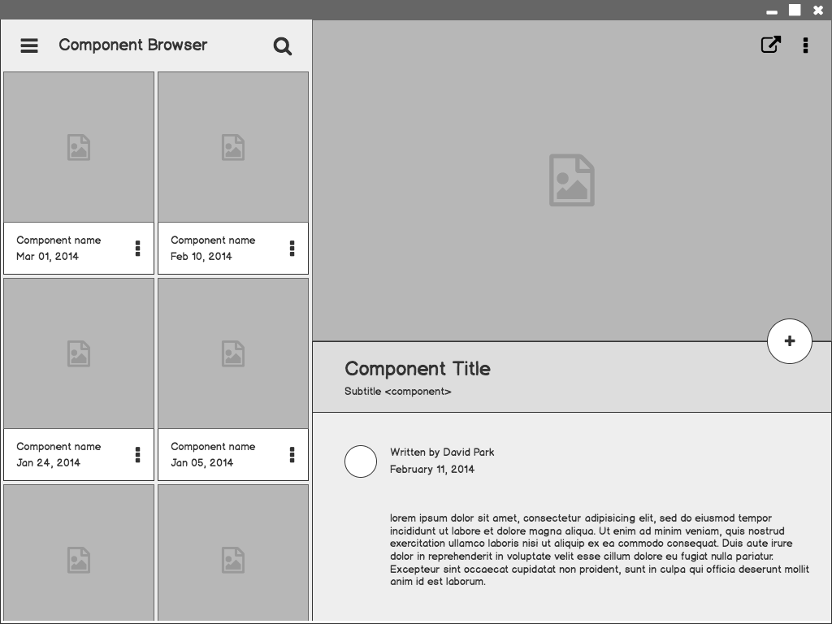
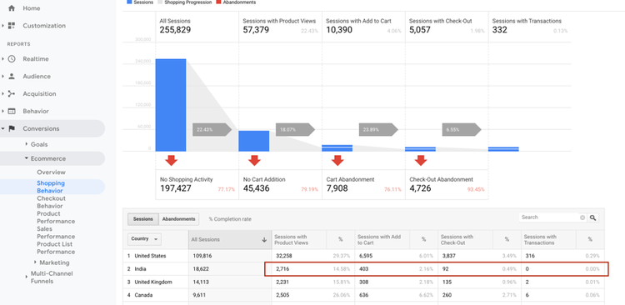

Retail
Analysis
Performance Optimization of Ecommerce Store

Slide 2
Outline
Project By:
Aashish Rana, Ragavendran s, Saloni Jain
We are an E-Commerce Company that is continuously working on optimizing the app.
With the help of given data, We did analysis to draw the insights about
Customer Behaviour, Transactional Data
& Products Purchased.

Slide 3
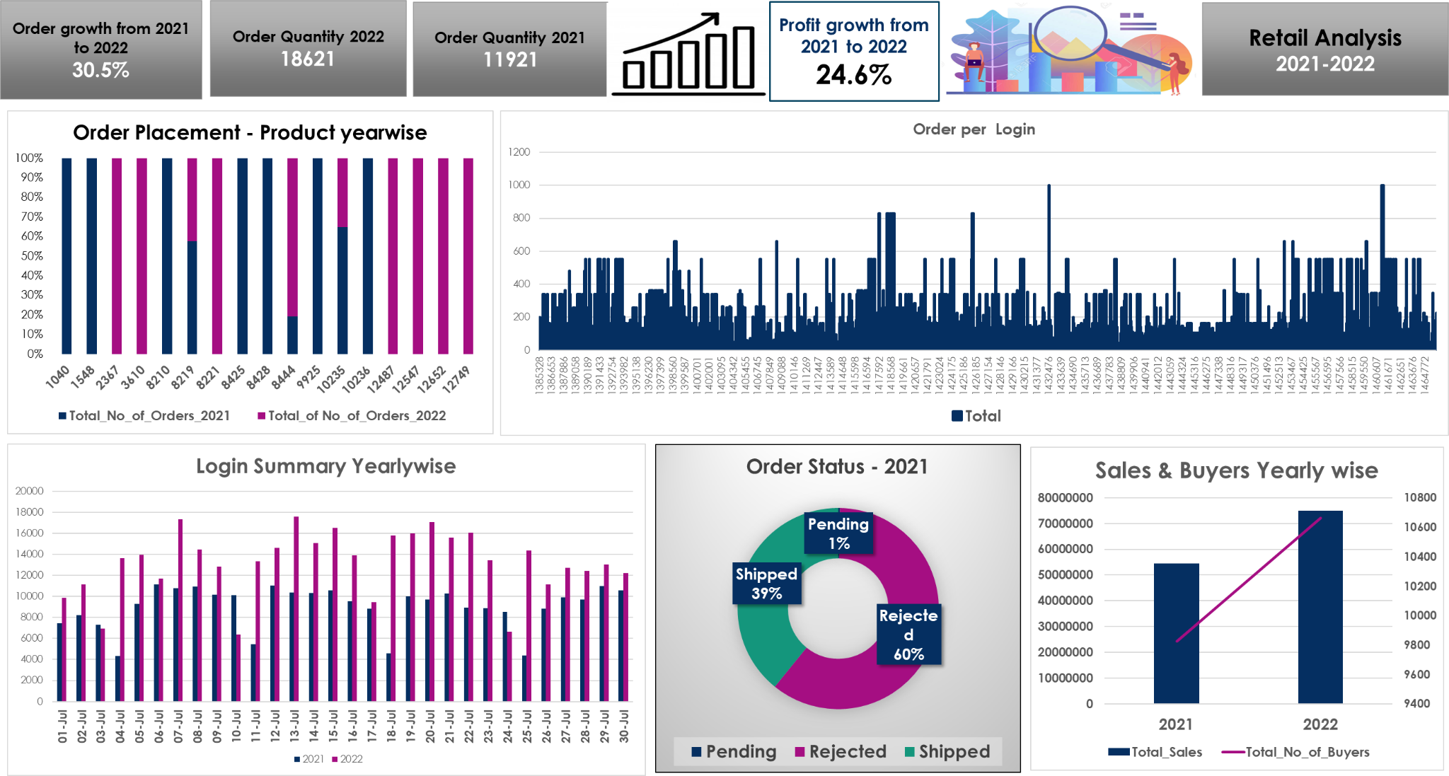

Slide 4
Key Insights
The order Growth from 2020 to 2021 is 30.5%
Profit Growth from 2020 to 2021 is 24.6%.
Number of login affecting number of orders placed.
Majority of orders got rejected in july 2021.

Slide 5
Unique Findings
Sales has Significantly increased from 2021 to 2022.
The App performs Better Now as the No.of logins and orders have increased.
No of Users has also shown Increase no.of records.
Open Ended Part of the project

Slide 6
Challenges
The Reason for Rejection of large number of orders.
Reason of low profit in 2021.
There is No Repeat Customers Data Available.
Too much variation in Order placements.
Rate of new customer acquisition is low.
1

Slide 7
Learnings
knowledge gained from the process of conducting a project.
Team Work
Plan & Manage time.
Give and Receive Feedback on Performance.
Break Complex tasks into parts
Delegating tasks.

Slide 8
Thank you

